Slide 1
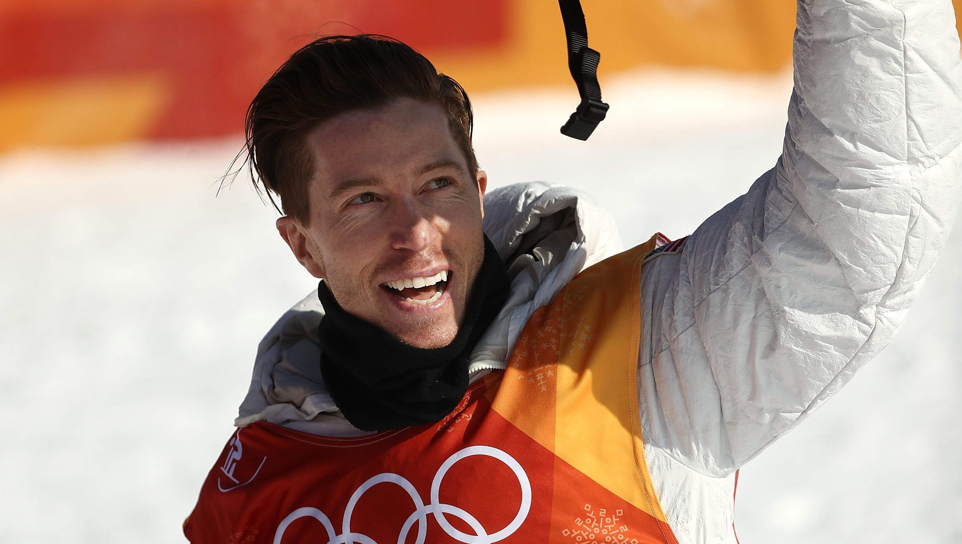

Shaun Roger White
Ethan Kanu

Slide 2
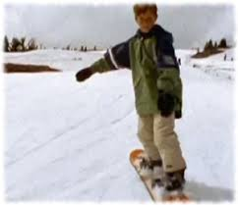
BEFORE LIFE
Shaun Roger White Shaun Roger White (born September 3, 1986) as an American professional snowboarder and before he started snowboarding when he was five. He was born with congenital heart defect and had two cardiac surgeries before the age of five

Slide 3
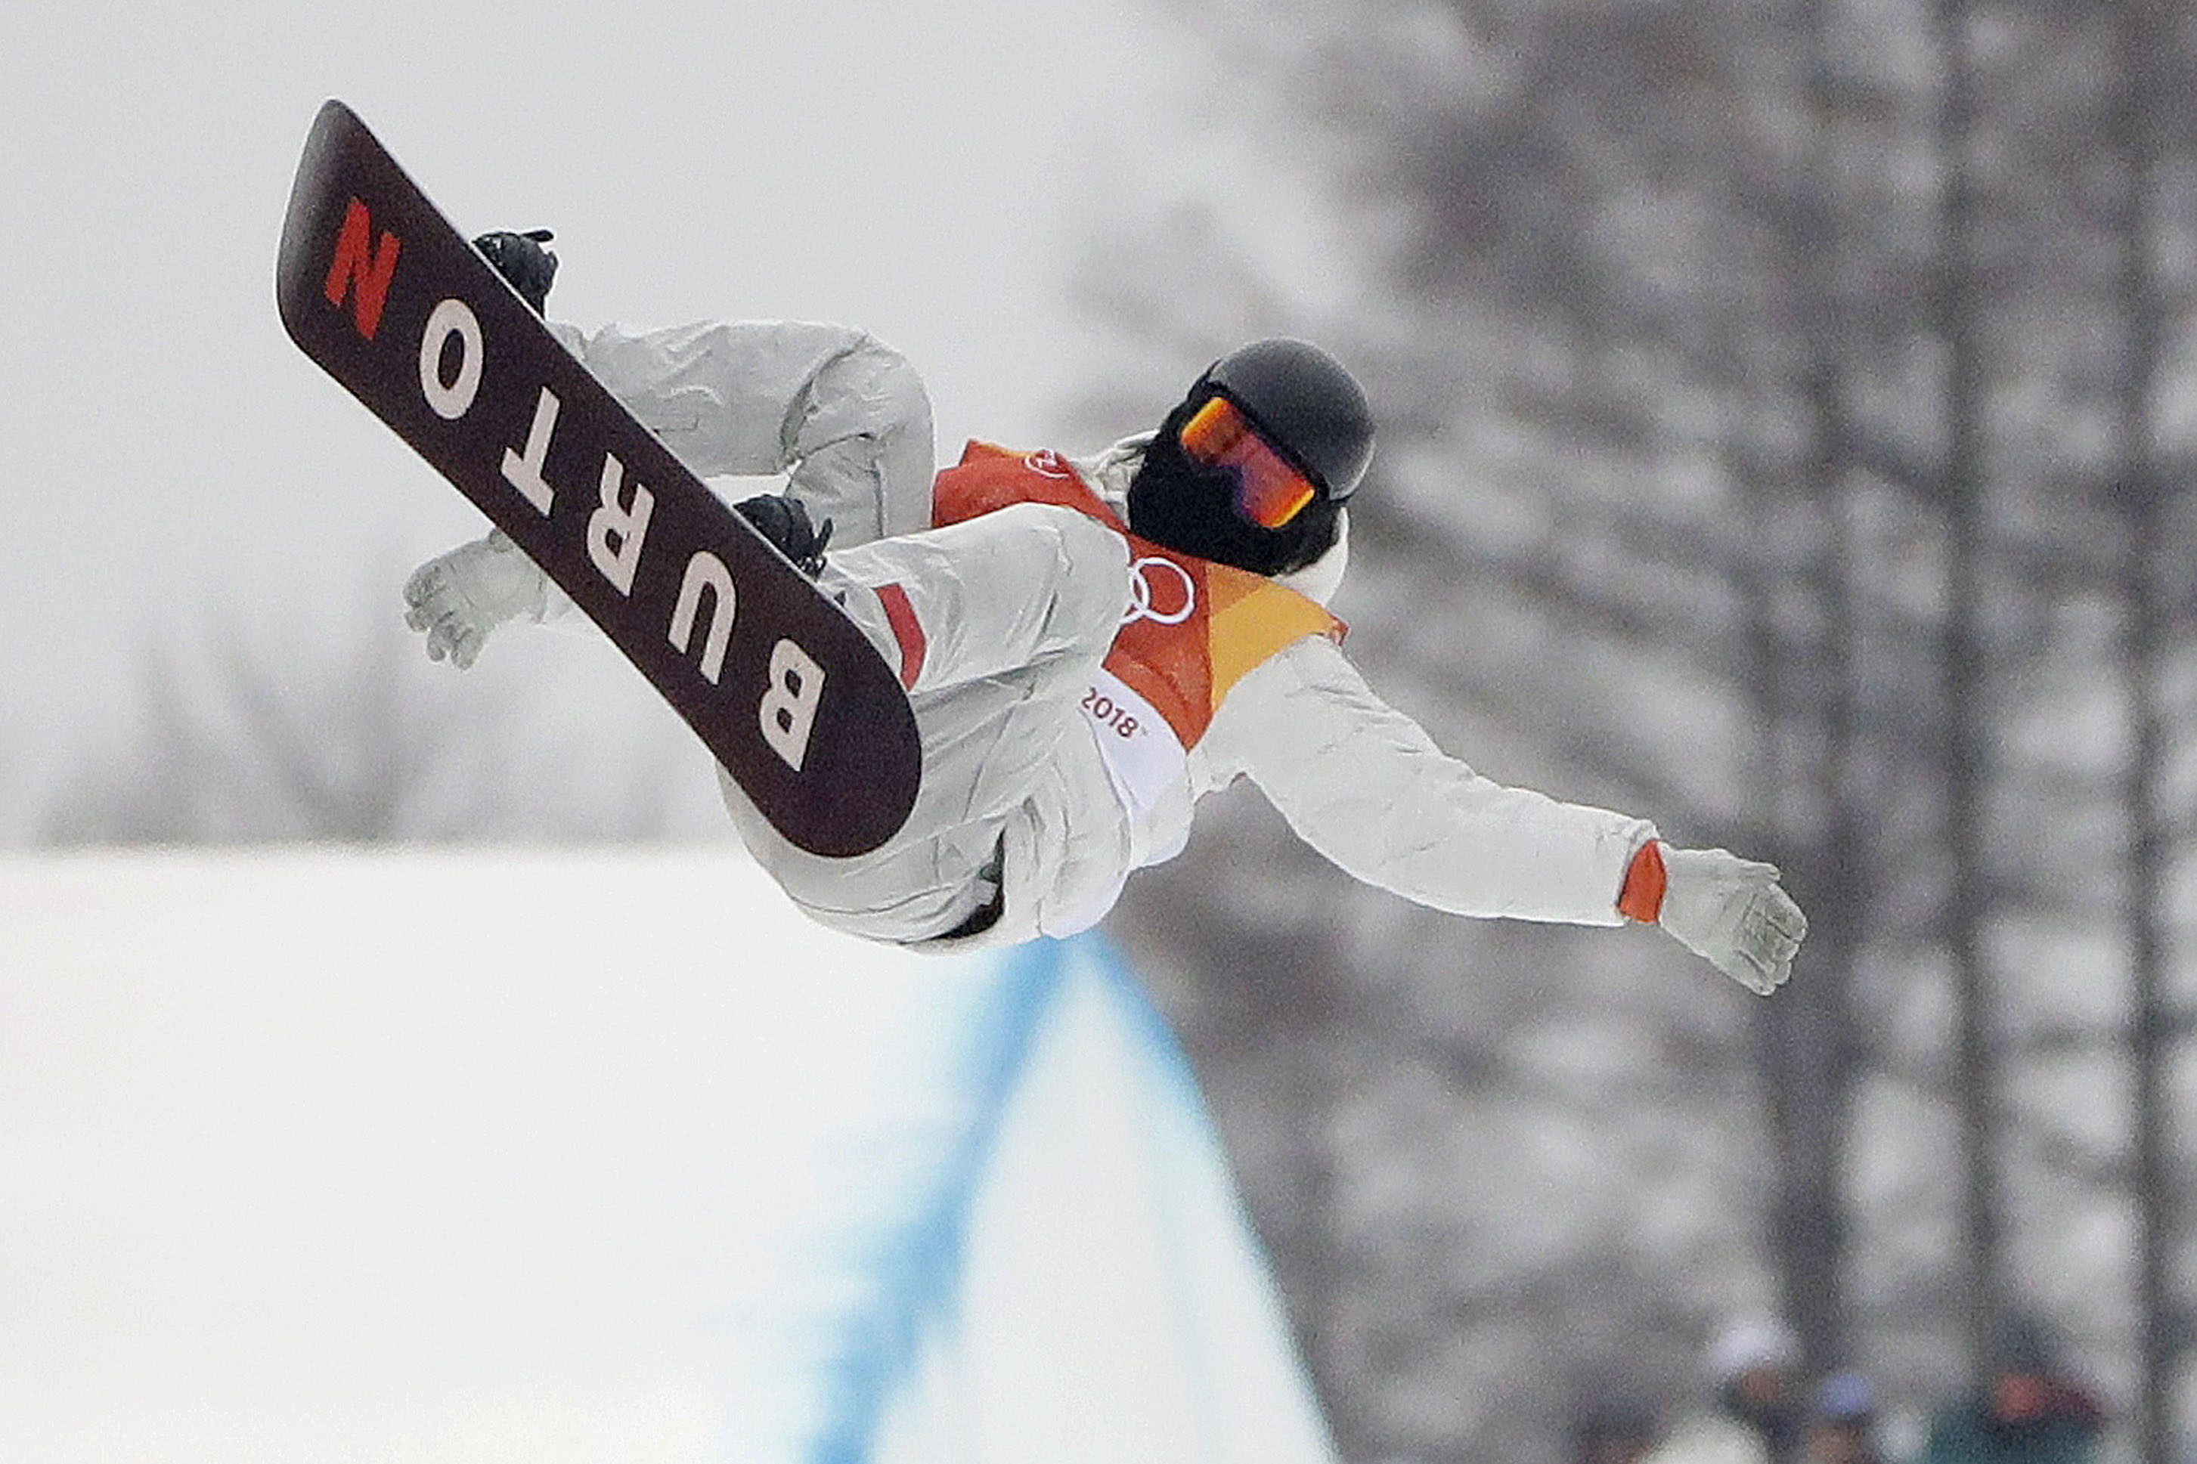
How he inspired me
He has so many cool tricks and lots of awesome stunts with a trick called the double mc twist witch is this insane trick where he does an aerial and a double backflip to a perfect landing

Slide 4
After snowboarding
After his crier of being a snowboarder he became a musician he went to lots of his concerts and lived his life

Slide 5


